Slide 1
Test Management Office
Test Automation Metrics
February 2017

Slide 2
FUNCTIONAL AUTOMATION

Slide 3
Volume & Velocity of Automated Testing (February 2017)
Month | Number of Projects Worked on | Number of Existing Tests Available (Smoke and Regression) | Number of New Tests Planned(Smoke+Regression) | Number of Scripts Created | Number of Times Ran /Executed | Avg Time per Run (mins) | Number of Defects Found
Jan | 3 | 462 | 26 | 25(1-descoped) | 3345 | 21 | 9
Feb | 5 | 572 | 54 | 45(9-descoped) | 2307 | 24 | 11
Mar
Apr
May
Jun
Jul
Aug
Sep
Oct
Nov
Dec
totals
Charter : Confidential

Slide 4
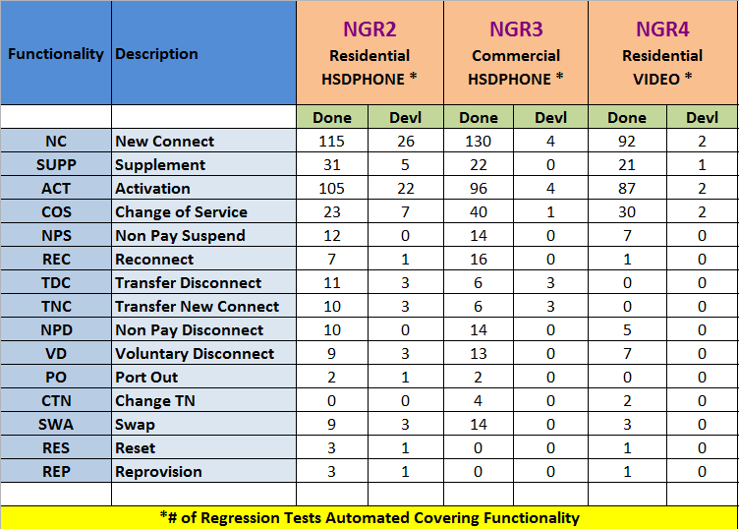
NG Automated Regression Inventory
(February 2017)
Charter : Confidential

Slide 5
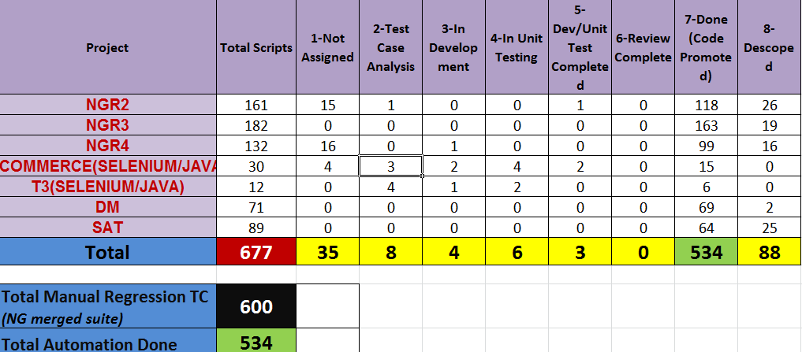
Automated Regression Development Status (Till February 2017)
Charter : Confidential

Slide 6
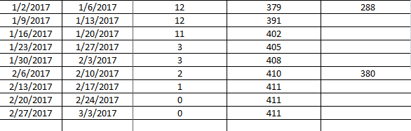
NG Automated Regression Development Status (February 2017)
Charter : Confidential

Slide 7
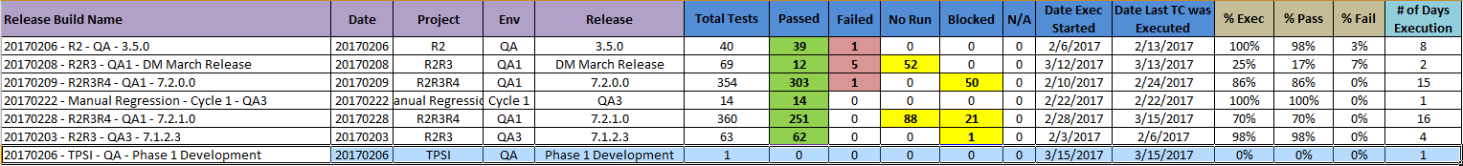
NG Automated Regression Execution Status (February 2017)
Charter : Confidential

Slide 8
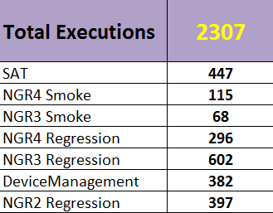
NG Automated Test Executions (February 2017)

Slide 9
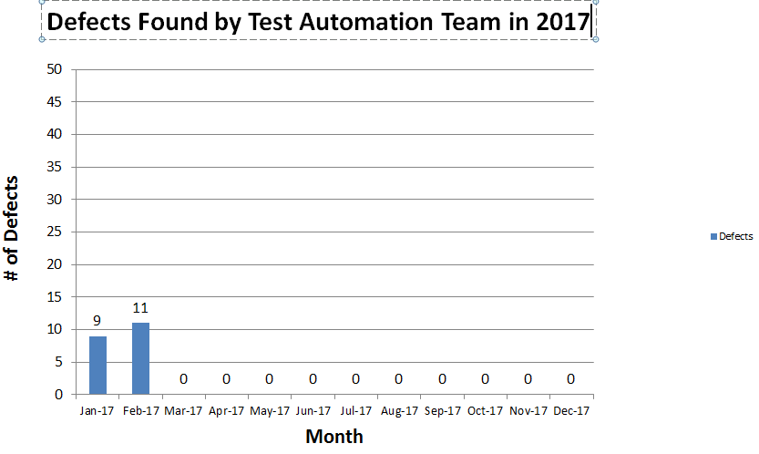
Automated Test Defects (February 2017)

Slide 10
PERFORMANCE TEST

Slide 11
Volume & Velocity of Performance Testing
(Febuary 2017)
Month | Number of Projects Worked on | Questionnaires Completed | Number of Tests Planned | Test Plans Created | Number of Scripts Created | Number of Runs | Avg Time per Run (mins) | Number of Reports Created
Jan | 4 | 3 | 3 | 3 | 20 | 19 | 18 | 2
Feb | 7 | 4 | 10 | 3 | 22 | 15 | 25 | 2
Mar
Apr
May
Jun
Jul
Aug
Sep
Oct
Nov
Dec
Totals
Charter : Confidential

Slide 12
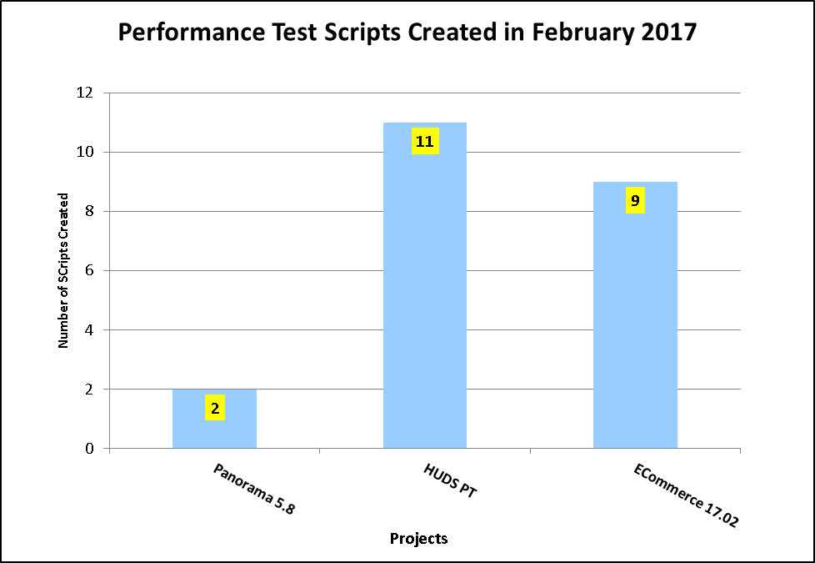
Performance Test Scripts Created(February 2017)

Slide 13
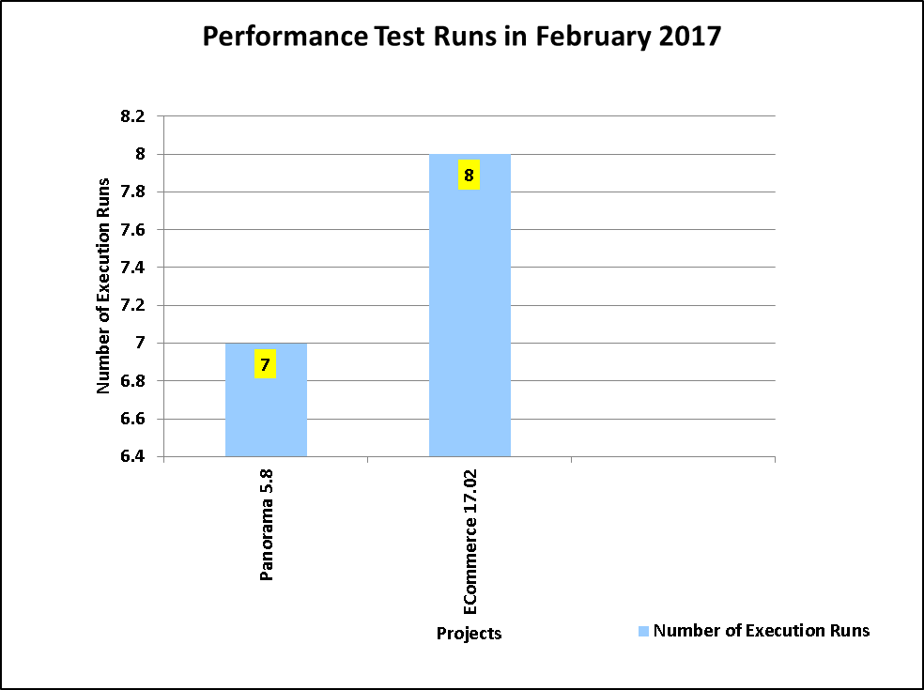
Performance Test Runs ( February 2017)

Slide 14
AUTOMATION in TEST DATA MANAGEMENT

Slide 15
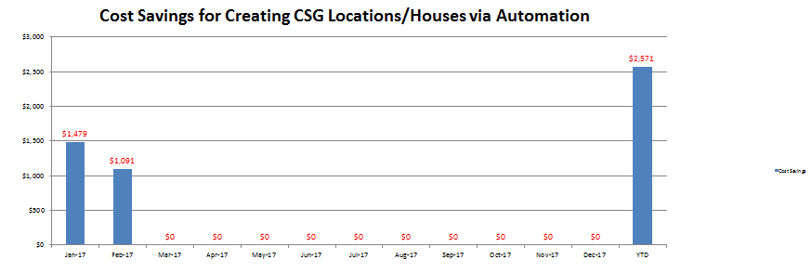
Actual Cost Savings in Test Data Management using CSG Location Automation (Jan ’17 – Dec ‘17)

Slide 16
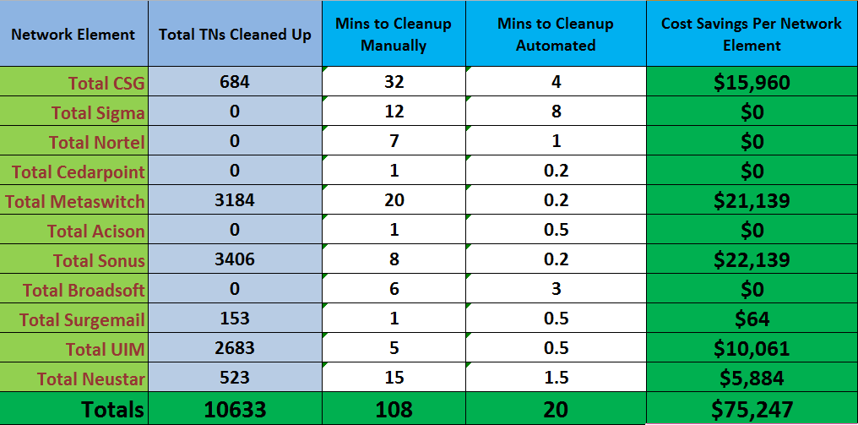
Actual Cost Savings in Test Data Management using TN Cleanup Automation (February 2017)

Slide 17
Actual Cost Savings in Test Data Management using TN Cleanup Automation (2017)

Slide 18
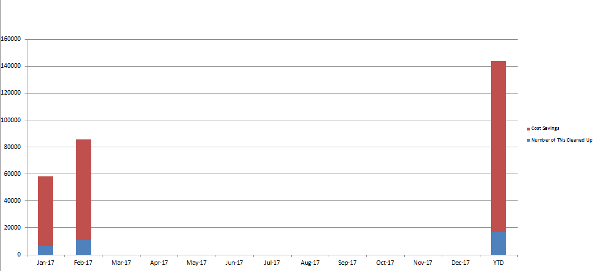
Actual Cost Savings in Test Data Management using TN Cleanup Automation (2017)

Slide 19
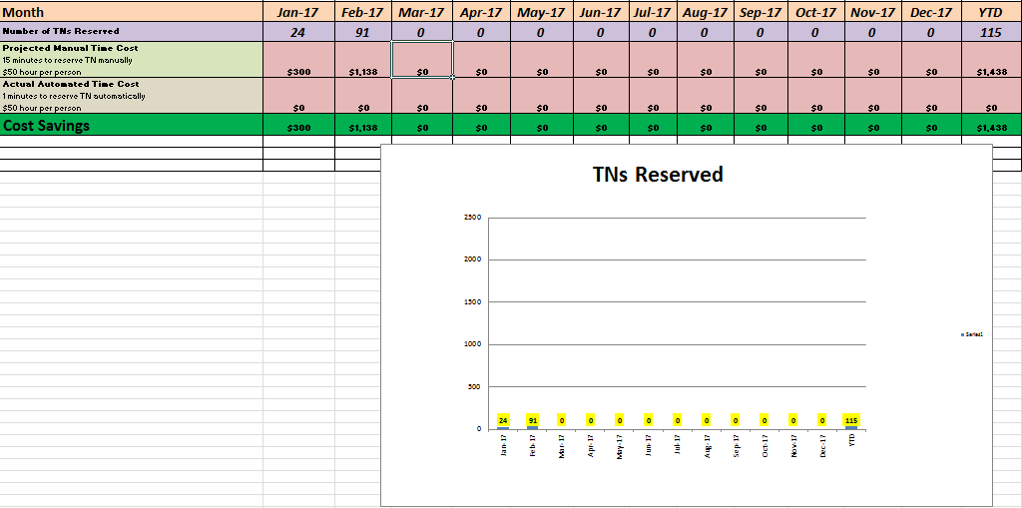
Actual Cost Savings in Test Data Management using TN Reservation Automation (Jan ’17 – Dec ‘17)

Slide 20
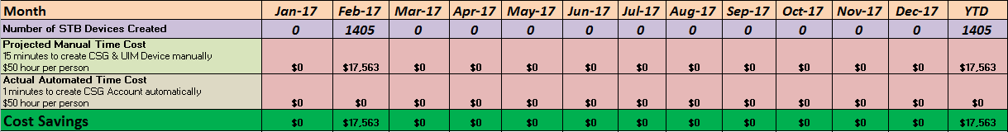
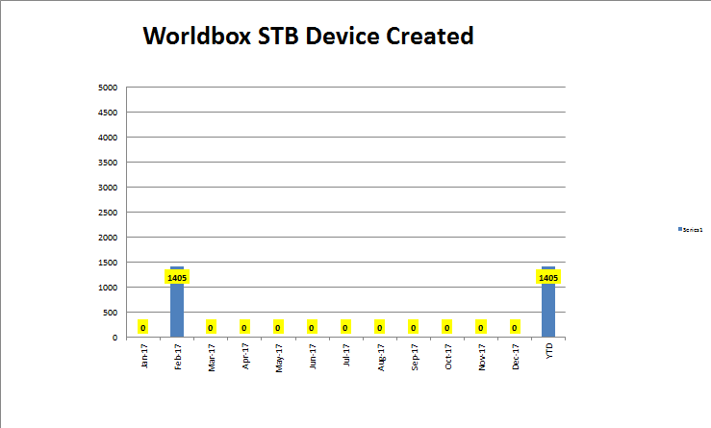
Actual Cost Savings in Test Data Management using STB Devices Automation (Jan ’17 – Dec ‘17)

